Slide 1
Unit Five

Slide 2
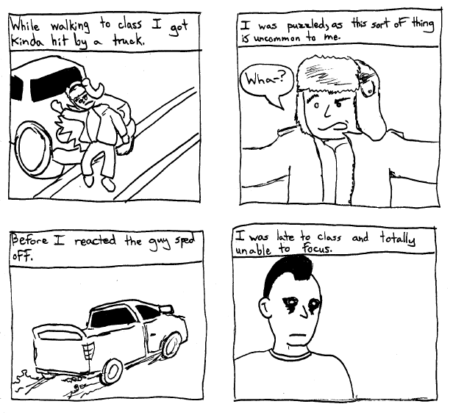
1. Anecdote: a short account of an incident in someone’s life, tale, story, vignette
Unit 5
Noun

Slide 3
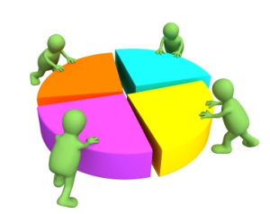
2. Consolidate: to combine, unite; to make solid or firm, merge
Unit 5
Verb
The siblings decided to consolidate their resources in order to buy a car.

Slide 4
3. Counterfeit: n. an imitation designed to deceive; adj. not genuine, fake; v. to make an illegal copy
Unit 5
Noun
or
Adjective
or
Verb
The painting was a counterfeit of Van Gogh’s Sunflowers. (n.)
The forger was selling counterfeit postage stamps. (adj.)
It is a crime to counterfeit money. (v.)

Slide 5
4. Docile: easily taught, led, or managed, manageable, teachable; obedient
Unit 5
Adjective

Slide 6
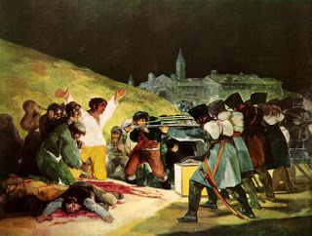
5. Dominate: to rule over by strength or power, control; to tower over, command due to height
Unit 5
Verb
History shows us that powerful nations tend to dominate weaker ones.
Goya’s “The Third of May”

Slide 7
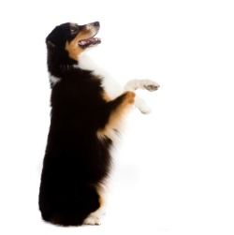
6. Entreat: to beg, implore, ask earnestly, plead
Unit 5
Verb
The dog’s eyes seemed to entreat me for an extra helping of dinner.

Slide 8
7. Fallible: capable of being wrong, mistaken, or inaccurate, imperfect
Unit 5
Adjective
The researcher’s fallible methods led to faulty conclusions.

Slide 9
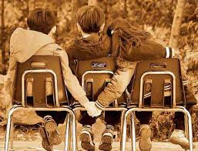
8. Fickle: liable to change very rapidly, erratic; marked by a lack of constancy or steadiness, inconsistent
Unit 5
Adjective
Get it?

Slide 10
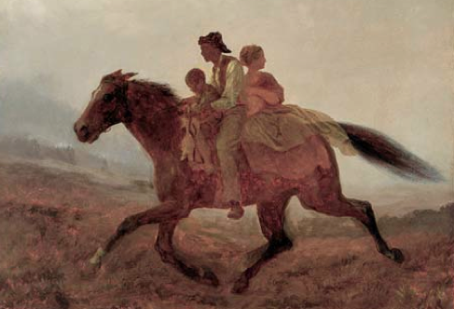
9. Fugitive: n. one who flees or runs away, runaway, deserter; adj. fleeting, lasting a very short time, elusive; wandering; difficult to grasp
Unit 5
Noun
or
Adjective
Painting:
“The Fugitive Slaves” by Eastman Johnson, 1860

Slide 11
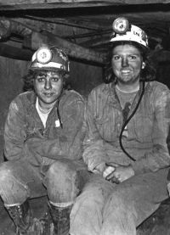
10. Grimy: very dirty, covered with dirt or soot, filthy
Unit 5
Adjective
The miners emerged from the pits with grimy hands and faces.

Slide 12
11. Iota: A very small part of quantity, speck, dab
Unit 5
Noun
The employer had not an iota of proof, but he blamed the new clerk for the theft anyway.

Slide 13
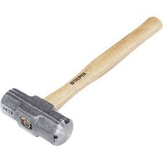
12. Maul: v. to beat or knock about, handle roughly, batter; to mangle; n. a heavy hammer
Unit 5
Verb
or
Noun
The tiger was about to maul its victim when the zookeeper intervened.
Maul: n.

Slide 14
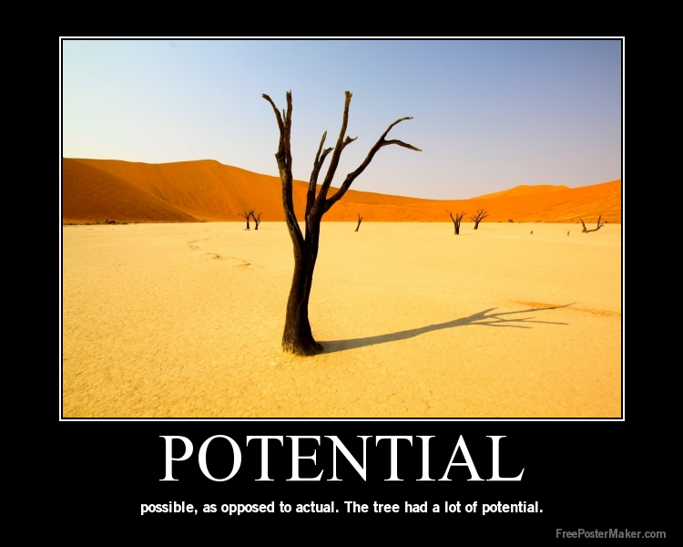
13. Potential: adj. possible, able to happen; n. something that can develop or become a reality, possibility
Unit 5
Adjective
or
Noun
Hurricanes are a potential threat to this area in the late summer and early fall. (adj.)
Noun

Slide 15
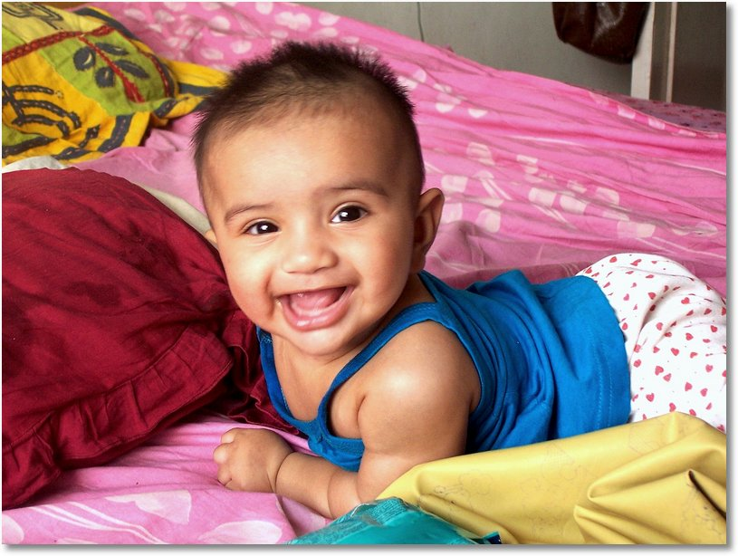
14. Radiant: shining, bright; giving forth light or energy
Unit 5
Adjective
Their baby has a radiant smile.

Slide 16
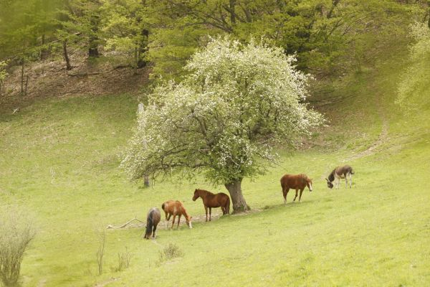
15. Rural: relating to farm areas and life in the country, countrified
Unit 5
Adjective
Harpursville is located in a rural area north-east of Binghamton.

Slide 17
16. Substantial: large, important; major, significant; prosperous; not imaginary, material
Unit 5
Adjective

Slide 18
17. Tactful: skilled in handling difficult situations or people, polite, skillful, discreet, diplomatic
Unit 5
Adjective
A tactful approach is usually the wisest one to take with coworkers.

Slide 19
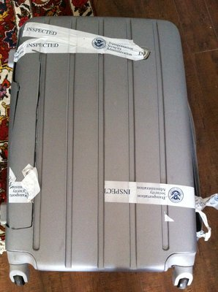
18. Tamper: to interfere with; to meddle rashly or foolishly with; to handle in a secret and improper way; monkey with, fool with
Unit 5
Verb
Please don’t tamper with our baggage.

Slide 20
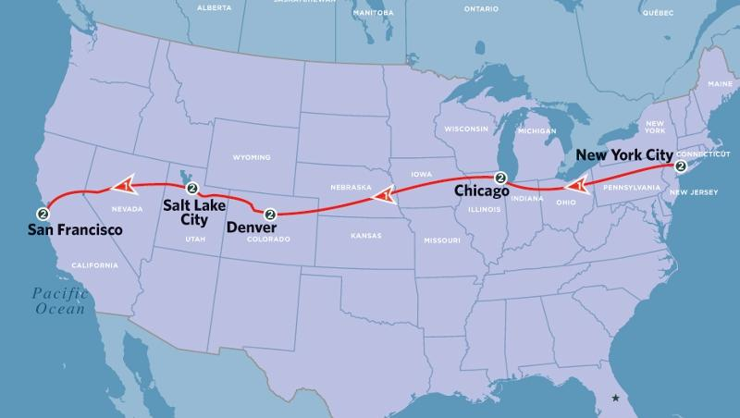
19. Ultimate: last, final; most important or extreme; eventual; basic, fundamental
Unit 5
Adjective
California is the ultimate destination on our cross-country trip.

Slide 21
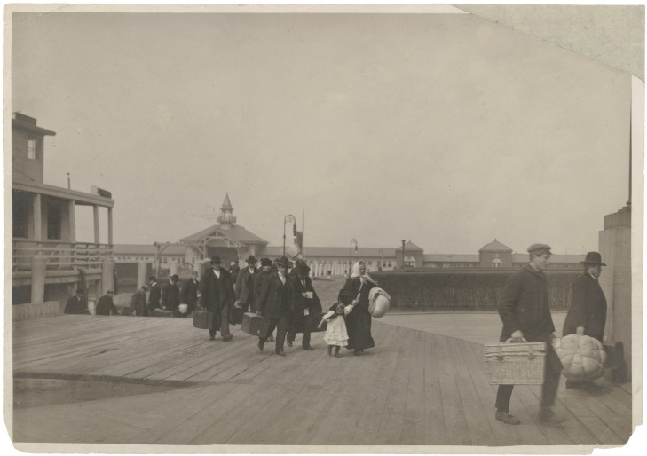
20. Uncertainty: doubt, the state of being unsure, doubtfulness, hesitation
Unit 5
Noun
It was the uncertainty about the future that was of the greatest concern to the immigrants.

